Slide 1
Worship in the Word
Alain Virgin

Slide 2
Provision for Obedience
2 Chronicles 29:5-11, 20-36

Slide 3
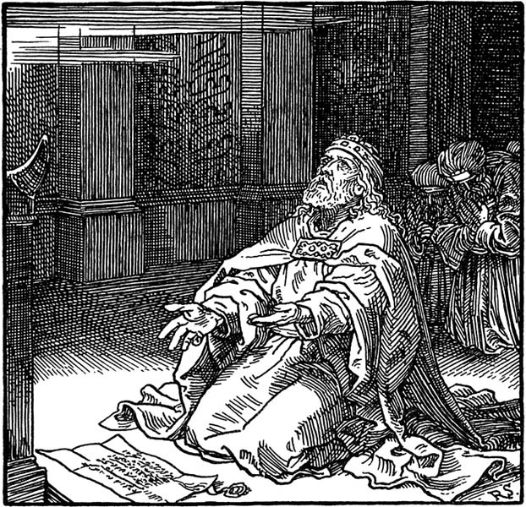
The Big Idea
Verse 36 – God will provide what you need to faithfully obey him

Slide 4

The Context
Uzziah – became a leper in the temple
Jotham – avoided the temple
Ahaz – shut up the temple
Israel in flux, assassinations abound
Assyria
Behaviour is not accidental

Slide 5
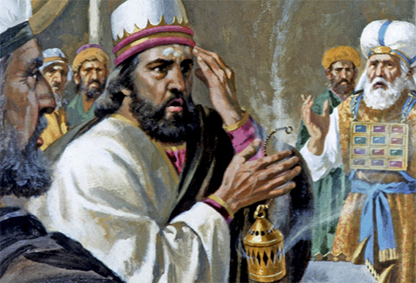
Uzziah
Wealthy, mighty and innovative
When his kingdom was secure he sought to usurp the priests
Pride
Body of Christ

Slide 6
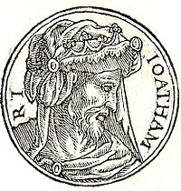
Jotham
Successful, steady
Prepared his ways before the Lord
The people acted corruptly
He did not enter the temple of the Lord
Fear
Paul going to Rome

Slide 7
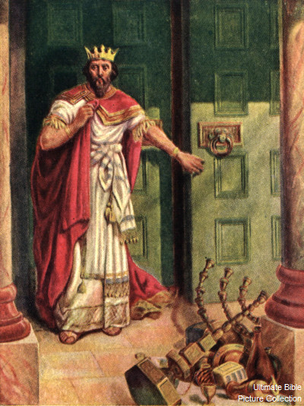
Ahaz
Wicked
The valley of the Son of Hinnom
Idolator
Defeated by Israel, Syria, Phillistine, Edom and Assyria
Shut up the temple
Impoverished Judah

Slide 8
Ahaz
Bitter
Flaky
Gal. 6:1-5
The woman at the well
Matthew 18:15-20

Slide 9
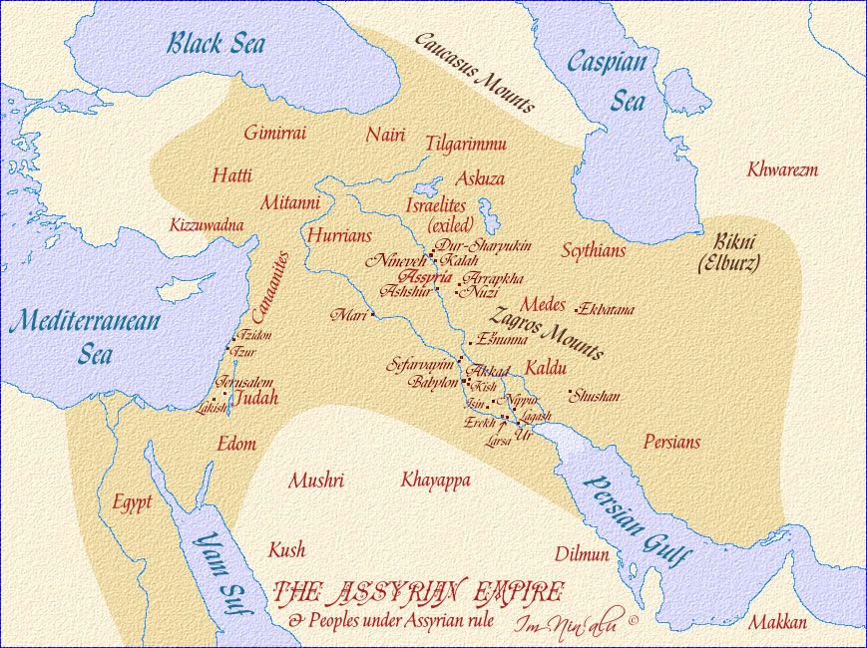
Assyria
Conquered Israel
Mocked God (Sennacherib)
Dominant anti-God culture

Slide 10

Practical Bits
Just obey
Be prepared to act alone
The Levites were more conscientious
God provided even on short notice
Do not expect everything to become easy
Sabbath
Worship

Slide 11

How We Are To Obey
Share the good news of the Gospel
Make disciples
Love one another
Love your neighbour
Keep God first

Slide 12

Now what are you going to do?
Do you struggle with fear, pride, or bitterness?
Do you need to strengthen your conviction?
Do you need Christ?
Have you been putting Christ first?

